Slide 1




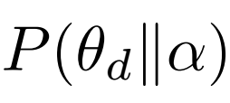
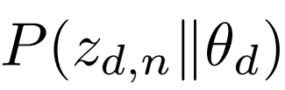
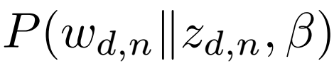




[Cluster of Words]
[Cluster of Documents]
Lines as
Documents
LDA
Topic Modeling
Textbook
Dataset
K1
K Topics
W1..WN → K1
W2…WN → K2
Kn
K2
Dirichlet
parameters
Document Topic
Distribution
Word-Topic
allocation
Observed
word
Topic-Word
distribution
Dirichlet
parameters
φ
D documents
K Topics

